Slide 1

TITRE DE LA PRÉSENTATION
HR EDA and Data Visualization
OGTIP Data Science Batch 2023
Project 2
Steven Lomon Lennartsson
Alexandre Chauvin

Slide 2
AGENDA
Introduction
The dataset and Aim
Data Pre-processing and Cleaning
Salary distribution
The high earners
The happiest employees
The unhappiest employees
Summary

Slide 3

INTRODUCTION
We are given limited HR data from a reputed organization. The dataset includes relevant information of the employees like id, designation, performance score, salary etc. We will clean and process the data, as well as make necessary visualization, in order to bring relevant inference and insights about the organization and its employees.
The project is done entirely in Google Colab. The data pre-processing is done using pandas and the data visualization is done using a combination of seaborn and plotly express.

Slide 4
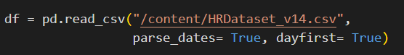
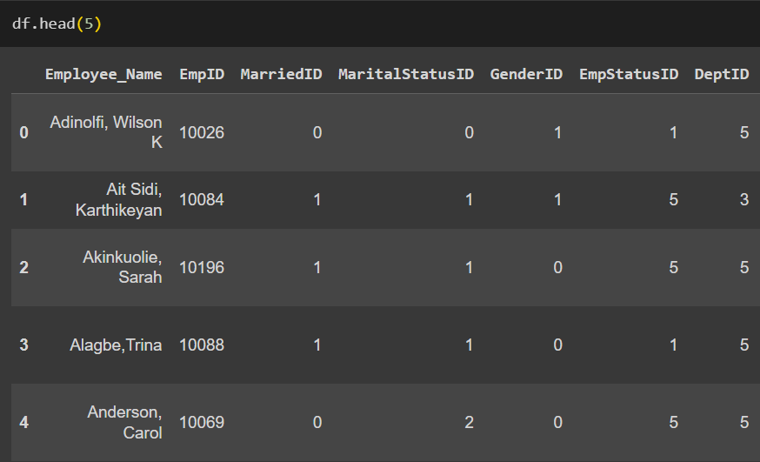
The Dataset and aim
The full dataset contains 311 rows and has a total of 35 columns. A full list will be shown on the next slide. The first five rows with the first seven columns are shown to the left.
”That’s a lot of data. What do we do with all of it?”
I am choosing to answer the following 4 questions:
How is salary distributed in the organization based on gender, department, ethnicity, and recruitment source?
What does the highest earners have in common?
What does the happiest employees have in common?
What does the unhappiest employees have in common?

Slide 5
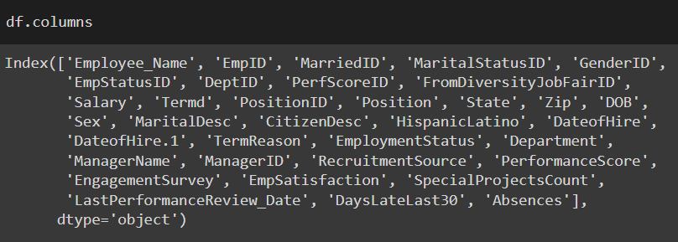
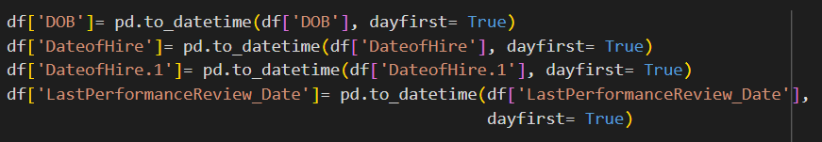
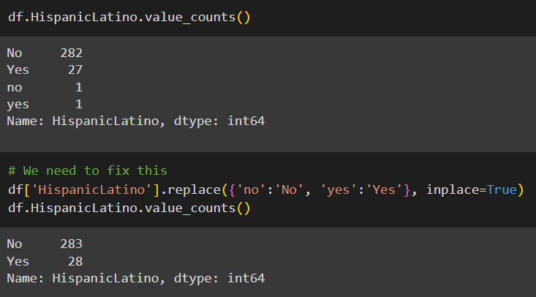
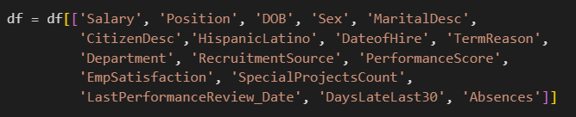
Data pre-processing and cleaning I
This stage involves getting a good understanding of the dataset, checking for missing values, making sure everything everything is in the same format, as well as removing unnecessary columns. I decided to drop the majority of ID columns as well as columns such as name and state where I feel that no insightful inference can be made.

Slide 6
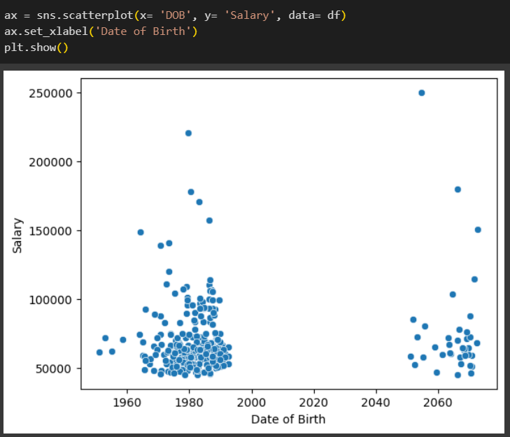
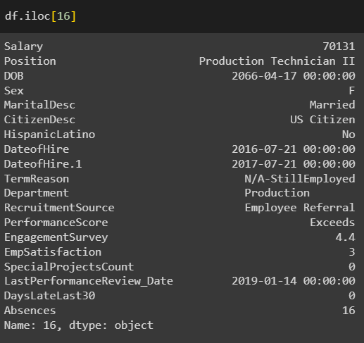
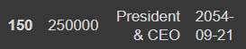
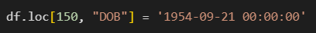
Data pre-processing and cleaning II
One of the biggest things that stand out when going through the dataset, which I didn’t notice during my initial pre-processing but later when plotting, is that we have 38 (!) people with a birth date year around 2060. Assuming we’re not dealing with time travelers, this is obviously incorrectly entered data, and a lot of it. So the question becomes: ”Do we remove these 38 people?”
I want to believe
that this isn’t deliberate but just rather incompetent people entering the data
One could argue that we should but I have chosen not to. Looking at every column other ’DOB’, we see that we have reasonable data, even the date-related ones. The one and only data point I have chosen to change is the CEO of the company:

Slide 7
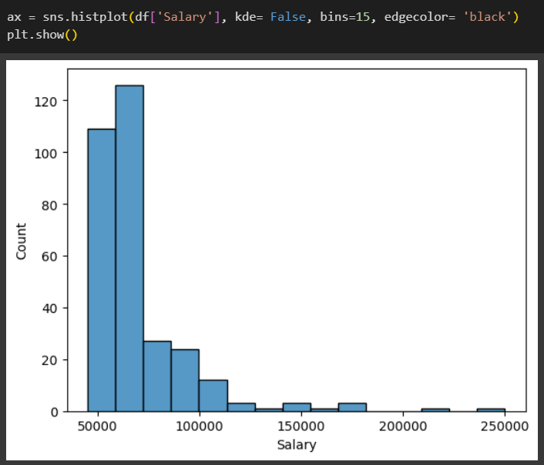
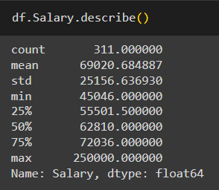
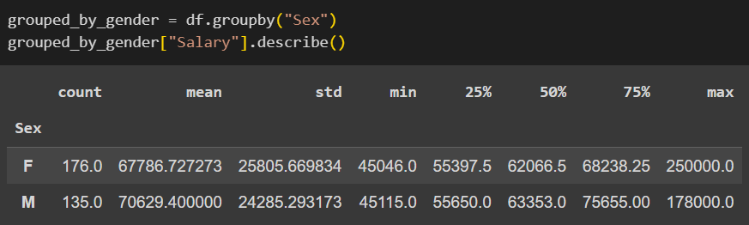
Salary distribution I
Let’s get a good understanding of the salary within the organization. The average salary is $69 000 with a standard deviation of ca $25 000.
The highest earner is the CEO with $250 000 who is also female. There are more females in the organization (176 vs 135 as we can see below) but men earn slightly more on average; $71 000 vs $68 000.

Slide 8
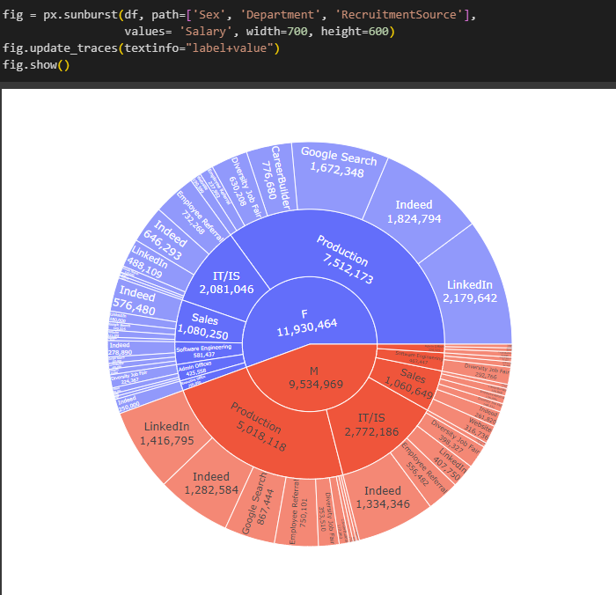
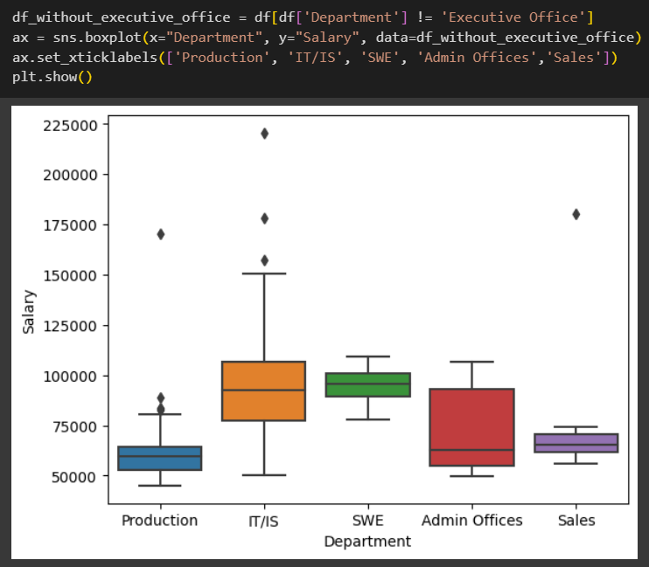
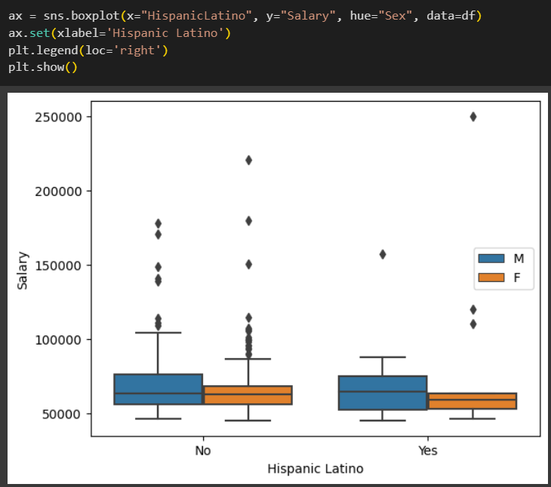
Salary distribution II
The following plots also help us get a good picture of how the salary is distributed between gender and department, as well as how salary is distributed based on recruitment source
Software engineers have the highest average salary but people in IT have the most outliers and high earners
The organization gives the vast majority of its salary to its production workers, but the avg salary is the lowest (it is worth noting that 67% of the organization is working in Production)
The CEO of the company is not only a female but also Hispanic Latino! We love to see it

Slide 9
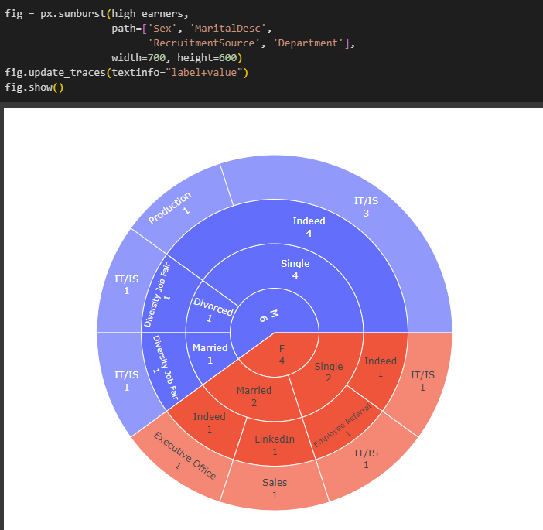
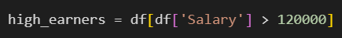
The high earners i
There is a total of 10 people in the organization that have a salary of $120 000 or higher. Looking at what they have in common gives some very interesting information!
Not a single software engineer! The majority of these people are in IT/IS
The CEO of the company is not only female and Hispanic Latino; she is also married!
The 4 single males have all also been recruited through Indeed! The rest are from the diversity job fair. Only a single person got recruited via LinkedIn

Slide 10
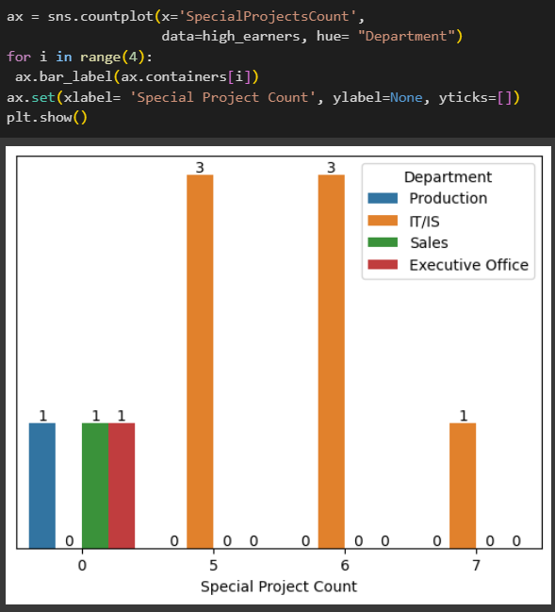
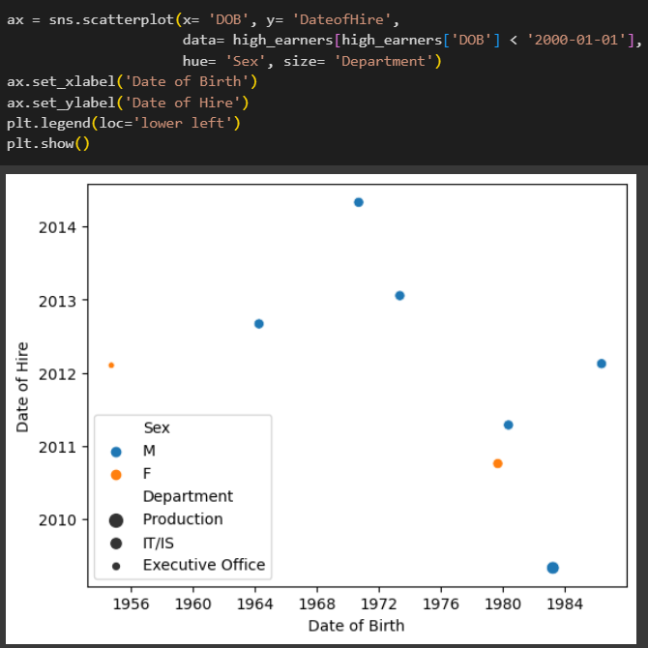
The high earners iI
Furthermore we can see that:
With one exception, all have had their last performance review close to the most recent year (2019)
With the exception of the CEO who is 63, the majority are in their 40s or 50s and have worked for ca 7 years
There are a lot of absences! Most probably excused absences for vacation etc. And very few being late
A lot of people here have done quite a few special projects
This plot is leaving out two data points with false DOBs

Slide 11
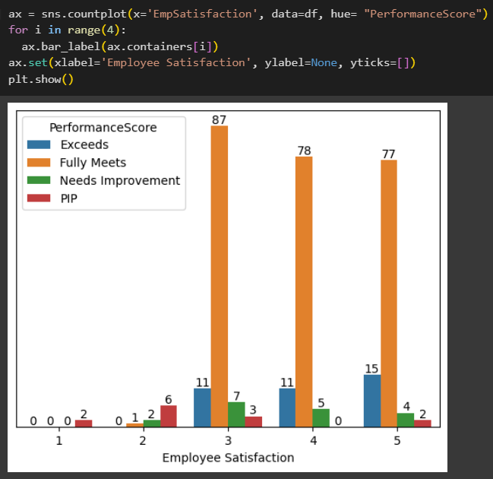
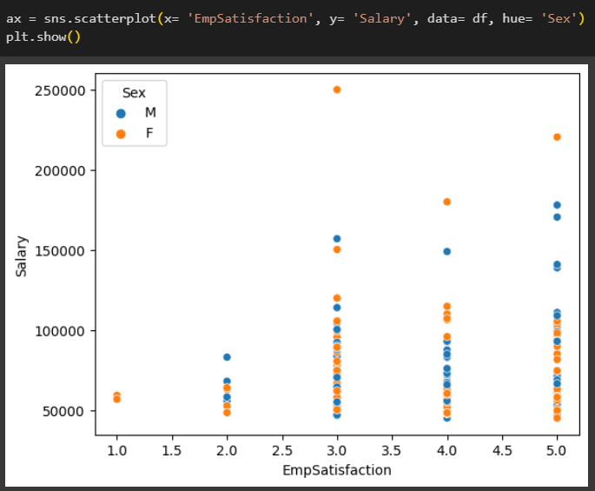
The happiest employees i
There is a very linear relationship between salary and employee satisfaction. But I have chosen to define the happiest people in the organization as the ones who have scored a 5 in Employee Satisfaction as well as are exceeding their work expectations. Happy high performers; there is a total of 15 of these

Slide 12
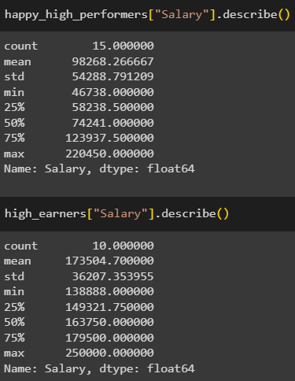
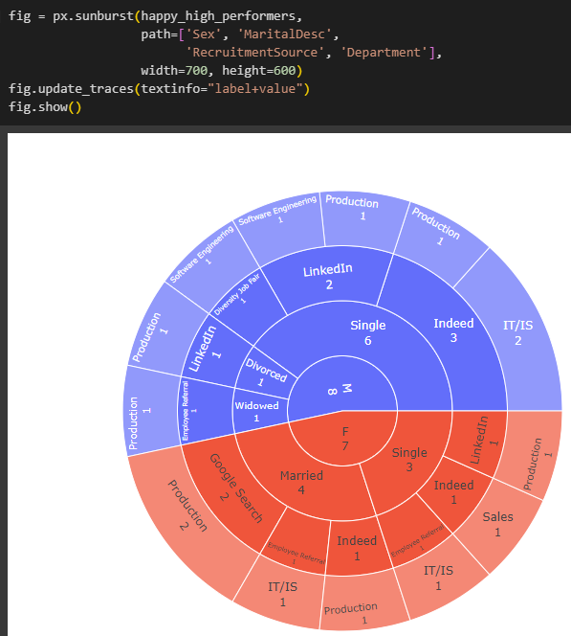
The happiest employees ii
We can see that the average salary is a lot lower here in this subset of employees but there is more standard deviation.
It’s an even split between the genders
The majority are single
Indeed and LinkedIn are the most common recruitment sources
There is a complete lack of people from the Admin or Executive office here. The most common department is Production (which is interesting since, as we will later, all but one of the unhappy people are also in Production)

Slide 13
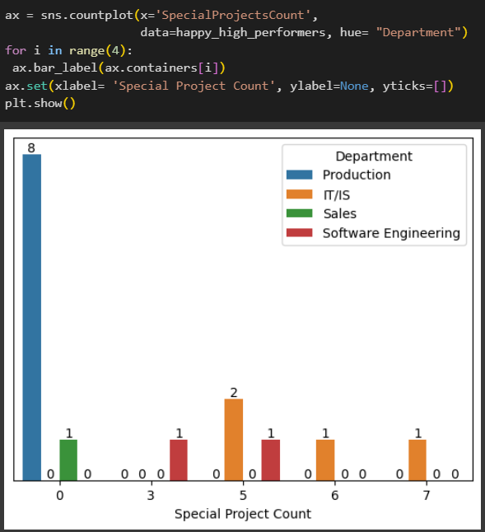
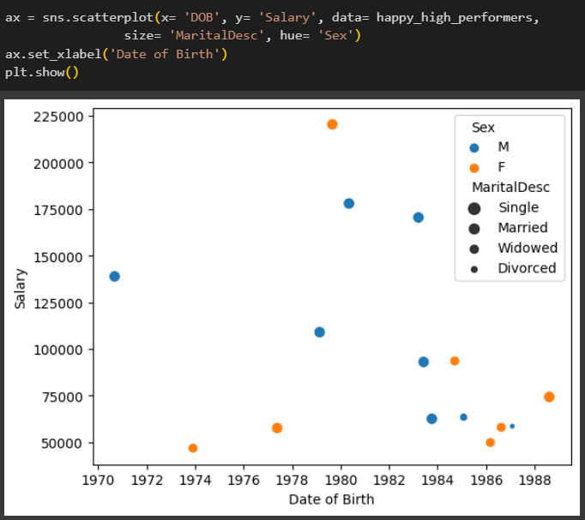
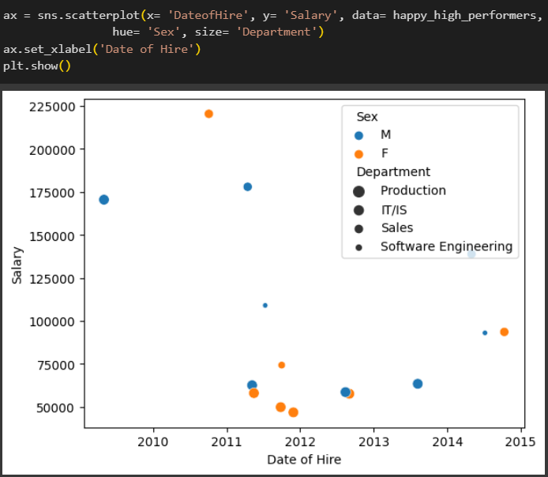
The happiest employees iii
There are no Hispanic Latino in this subset. But we also see that:
The majority of the people have been at the company for about 7 years and are in their 40s
Just like the high earners; the majority here have had their last performance review very recently and there are a lot of presumably excused absences (not shown here). Furthermore, there is not a single person being late in the last 30 days
Also like the high earners, there are quite a few special projects here. Also worth noting is that so far not a single special project has been given to Production

Slide 14
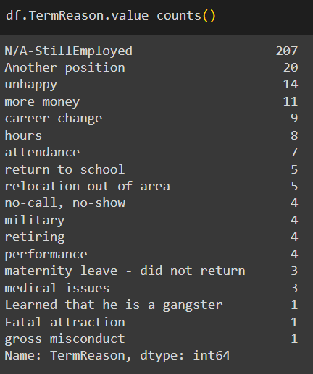
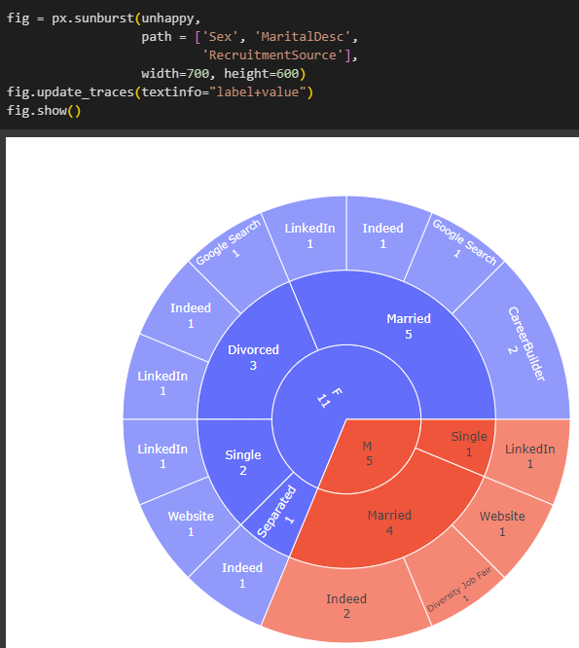
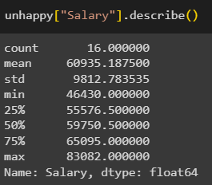

The Unhappiest employees i
Let’s look at the other end of the spectrum. Looking at the reasons for employee termination we see that there are 14 people that have quit the organization due to unhappiness. These 14 people along with the people that have scored 1 on Employee satisfaction will make up our subset of unhappy people of the organization
We can see that:
Just over 2/3 are female
The majority are married or divorced
The most common recruitment sources here as well are Indeed and LinkedIn
The average salary is ca $38 000 lower than that of the happiest people
I also think this was funny. I wish this person the best of luck in the future

Slide 15
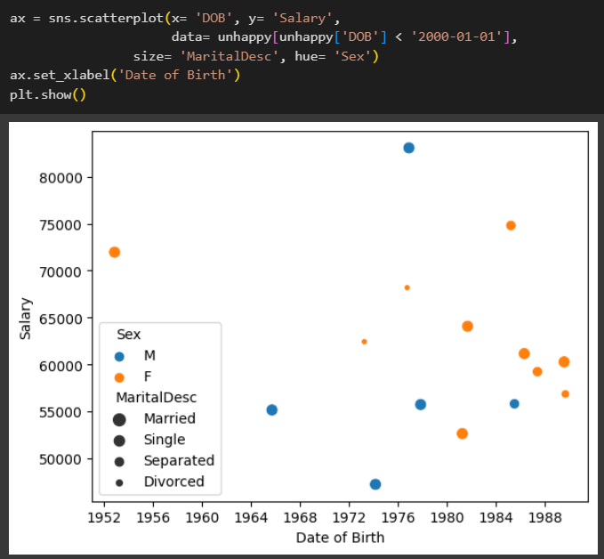
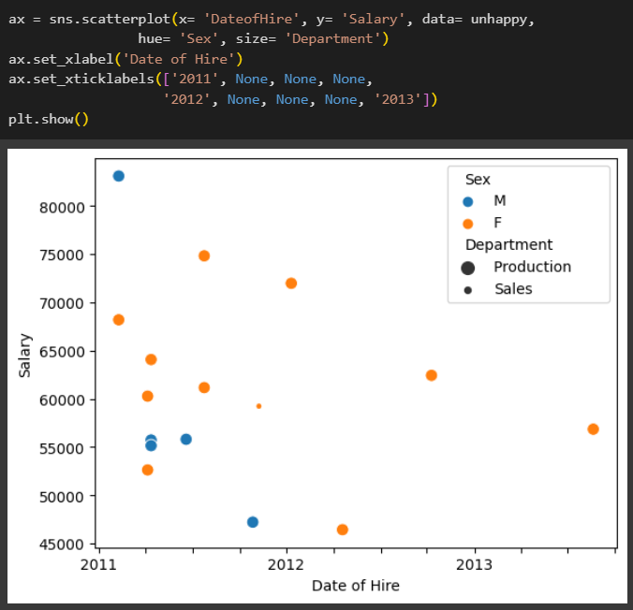
The Unhappiest employees ii
There is actually not a single Hispanic Latino here either. We can see both differences and similarities:
Just like the happiest people, the majority here have been at the organization for about 7-8 years but there are fewer outliers more recent in time here. The majority here are also in their 40s
A big difference is that the majority of people haven’t had a single performance review in the last 4-7 years. There are also a lot of people that have been late and I would like to guess some of the absences are not excused
There is not a single special project among these 16 in total and all but one are in Production
This plot is leaving out one data points with false DOB

Slide 16
SUMMARY
In conclusion, along with some further findings:
This seems to be a great organization! The CEO is a female Hispanic Latino, the average salary between the genders are nearly equal, and there are plenty of people able to exceed work expectations while still maintaining mental balance and satisfaction. They do however need to hire a new person responsible for entering data
All but one of the unhappy people are working in Production. I believe this is the biggest telltale sign here. Is it possible to be a happy high performer in Production? Yes, 8 of the happy high performers are! It seems possible with rather frequent performance reviews as well as making an effort to not be late and staying mentally active outside of work. But in general, the unhappiest people are all in production where there also only have been 4 special projects in the lifetime of the organization*. Maybe there needs to be some improvements to Production? Within production, all the unhappy people are also Production Technician except for one Production Manager*. Having a manager position in and of itself will not make you happy
Perhaps the biggest thing to take notice to from the unhappy people is that among those 16 there are actually 3 people that at the latest registration of employee satisfaction scored a 5*! Yet they quit the organization due to unhappiness. Numbers aren't everything. We are human after all
Some lessons from this dataset analysis that we all can remind ourselves of from time to time:
It takes time (and effort) to get truly integrated and feeling a sense of belonging in a company. Without effort, it can quite easily lead down a path of complacency and feeling stuck in life.
Money doesn’t equal happiness but is rather a gateway to more stability and time for loved ones and reflection. Work isn’t everything in life
I wish everyone reading this agency, gratitude, peace and delight in their life, both at work and outside of work
Thank you!
* Not shown here in the presentation. See the Notebook

